Slide 1
FACT FINDERS PRESENTS :
DESIGNING AN EBAY-LIKE DATA WAREHOUSE

Slide 2
agenda
Introduction
Project Plan
Data Overview
Bus Matrix & High-Level Design
Dimensional Modelling and ETL Implementation
Power BI Dashboard
Future Enhancements
Conclusion

Slide 3

INTRODUCTION
Designed a data warehouse for an eBay-style auction platform.
Modeled key business processes: item listings, bidding, user ratings.
Implemented ETL pipelines, a star schema, and Power BI dashboards.
Enabled deep insights into:
Bidding behavior
Item popularity
Auction success rates
User engagement metrics

Slide 4


Project Plan
Milestone:
  Bus Matrix & High-Level Design.
  Dimensional Modeling & ETL Implementation.
  BI Dashboard Creation & Demo.
Deliverables:
  Dimensional models.
  ETL scripts & documentation.
  Power BI dashboard with KPIs.

Slide 5
Data overview
🔹 Data Sources:
Items: Item IDs, names, types, reserve prices, sold status.
Bids: Bid IDs, user IDs, bid amounts, timestamps.
Users: User details including email, name, zip codes.
Ratings: User-to-user ratings, rating type, values.
Zipcodes: City, state, latitude, longitude.
Lookups: Item type and rating type reference tables.

Slide 6
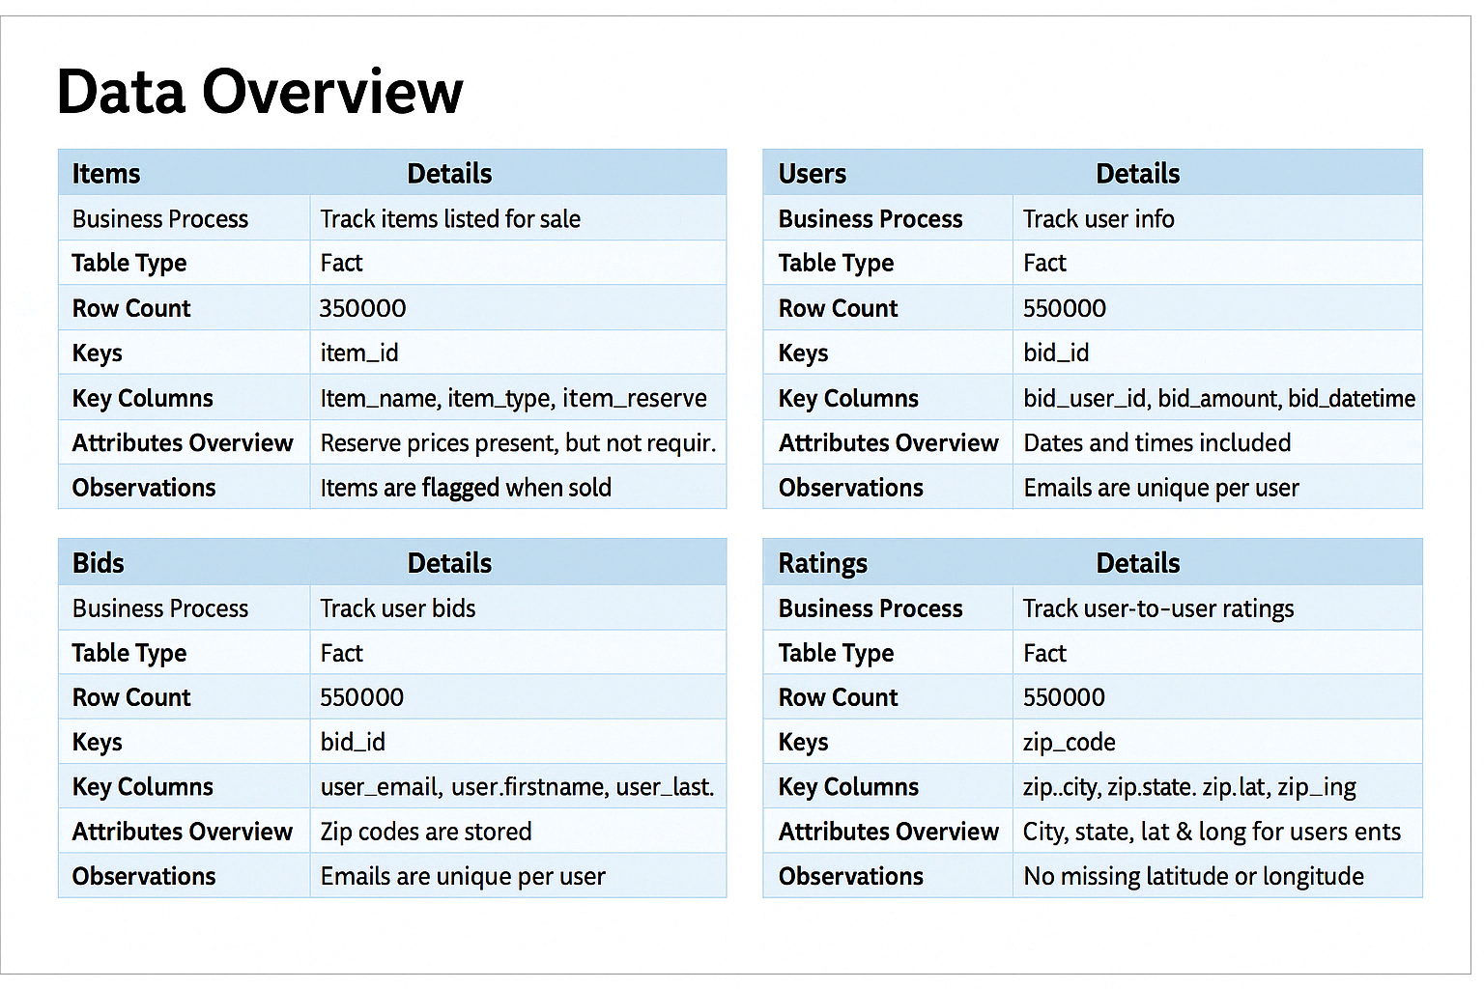

Slide 7
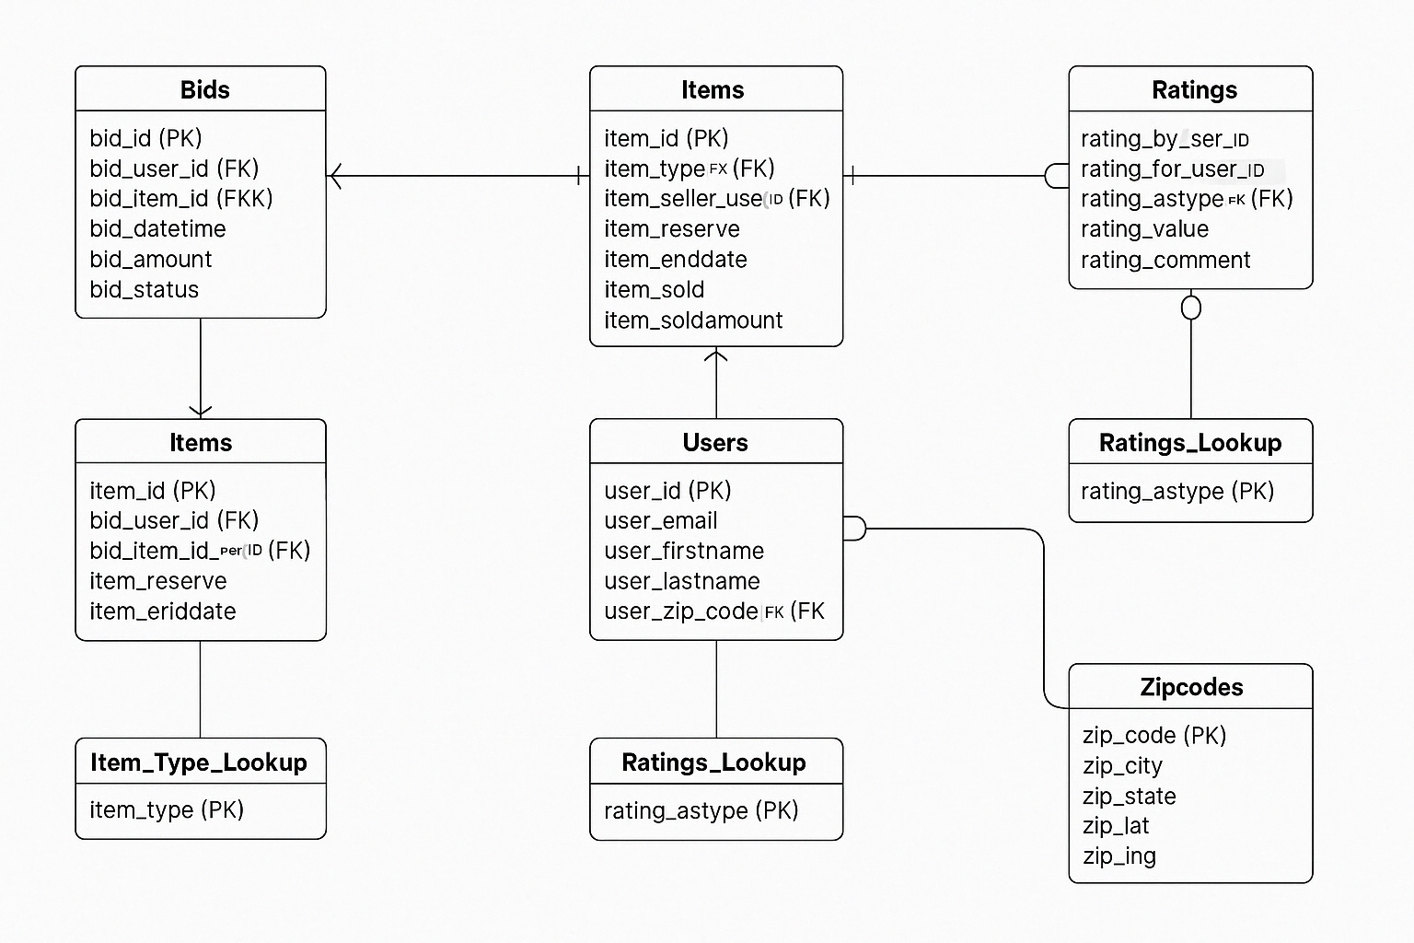
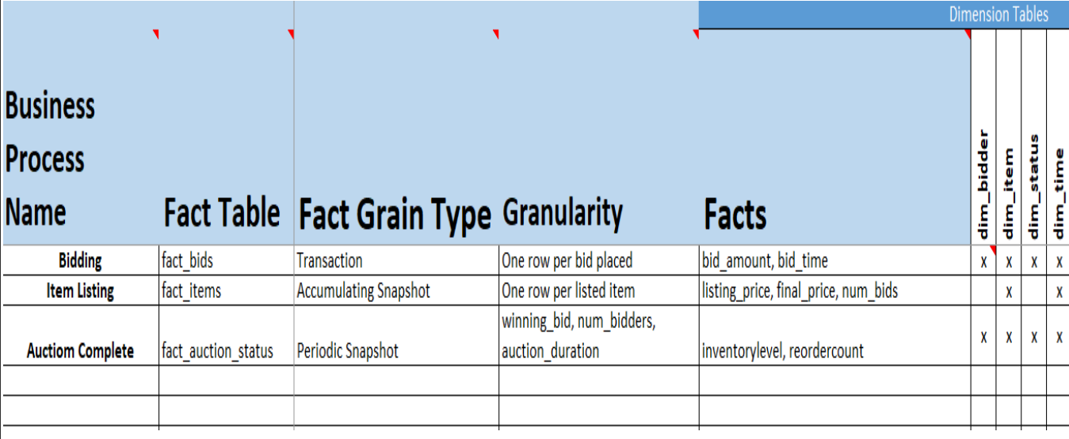
Bus Matrix & High Level Design

Slide 8

Dimensional Modeling & ETL Implementation
Architecture:
  Platform: Snowflake (cloud data warehouse).
  Layers: Raw, staging, star schema.
ETL Process:
1
2
3
Extract: From CSV to Snowflake stages.
Transform: SQL transformations.
Load: Fact and dimension tables.

Slide 9
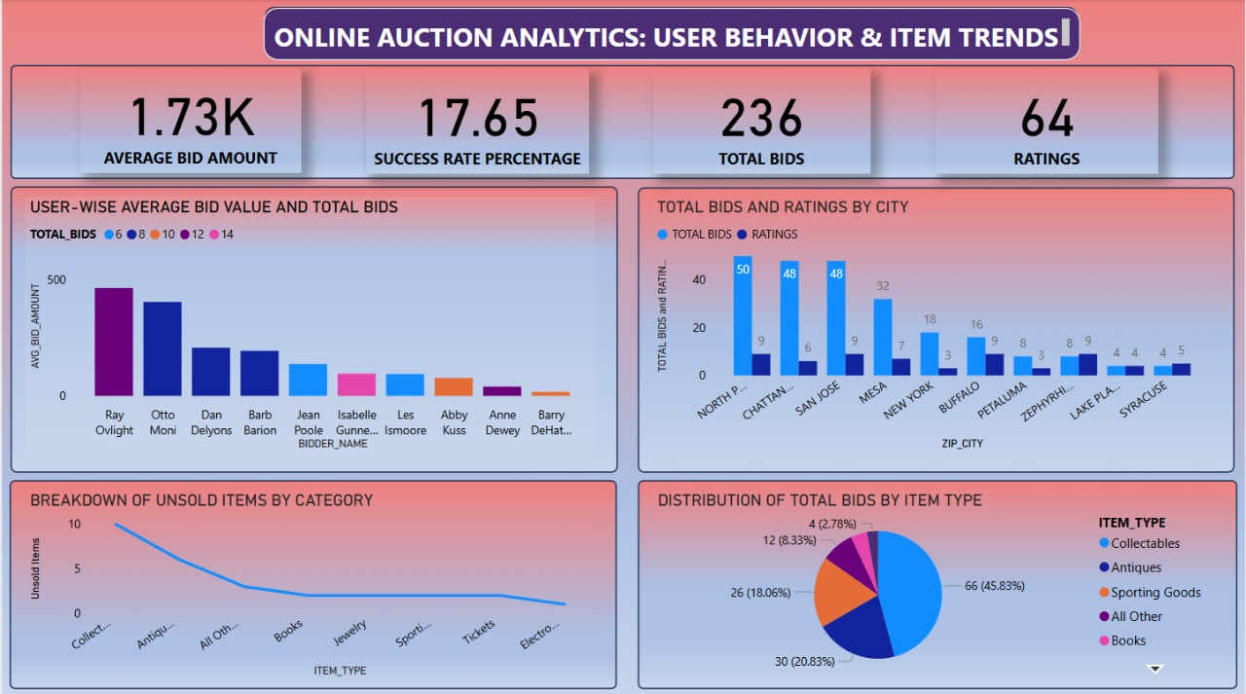
BI Dashboard Creation

Slide 10

Future Enhancements
Future Enhancements :
Integrate real-time bidding activity using streaming data pipelines
Apply predictive analytics to forecast auction outcomes
Extend analysis to seller performance and fraud detection
Enable mobile-optimized dashboards for quick executive insights

Slide 11

Conclusion
📦 Auction Success Rate: We identified which items met their reserve prices and uncovered patterns in successful vs. unsold listings.
🛍️ Item Popularity: Analysis of item types revealed which categories attracted the most bidder interest, helping guide inventory strategy.
👤 User Engagement: Bidder behavior insights, such as average bid amounts and top bidders, inform marketing and loyalty strategies.
🌍 Location-Based Trends: Geographic analysis highlighted high-activity zip codes and helped correlate bidder density with item demand.
⭐ User Ratings: Evaluated peer-to-peer trust through rating scores, assisting in quality assurance and platform credibility.

Slide 12
Thank you

